Slide 1
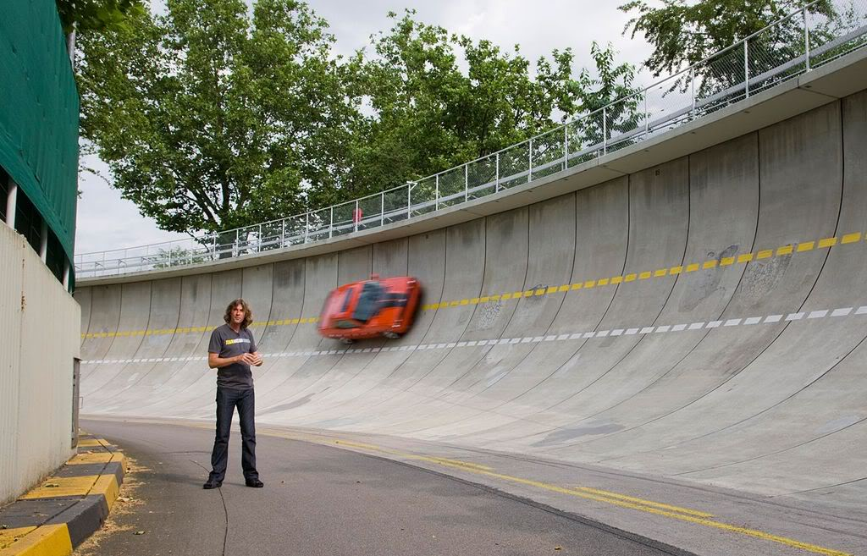
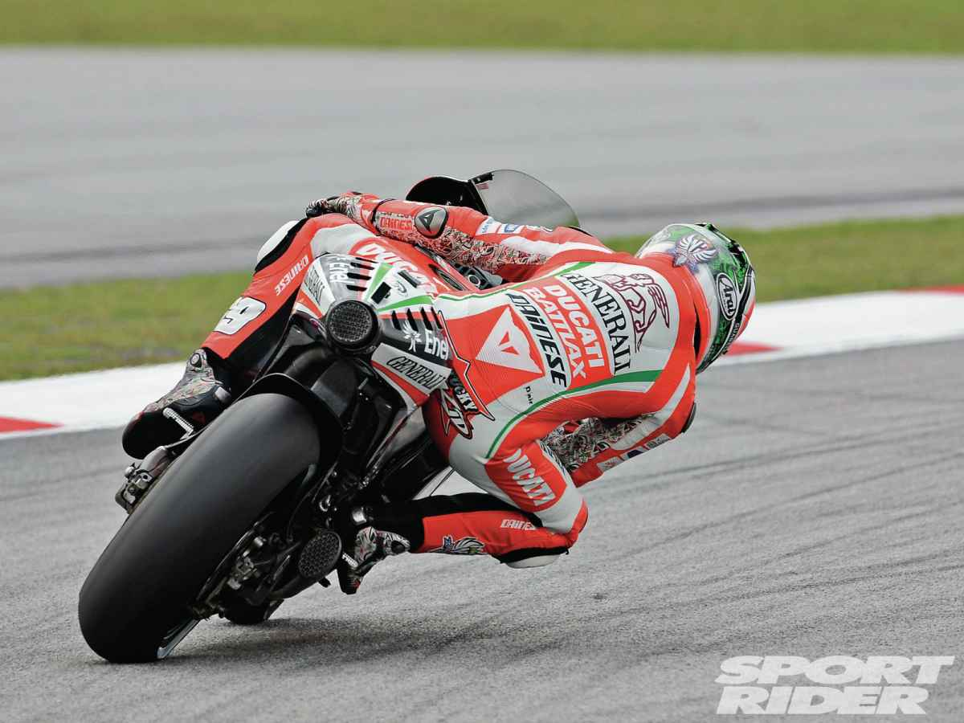
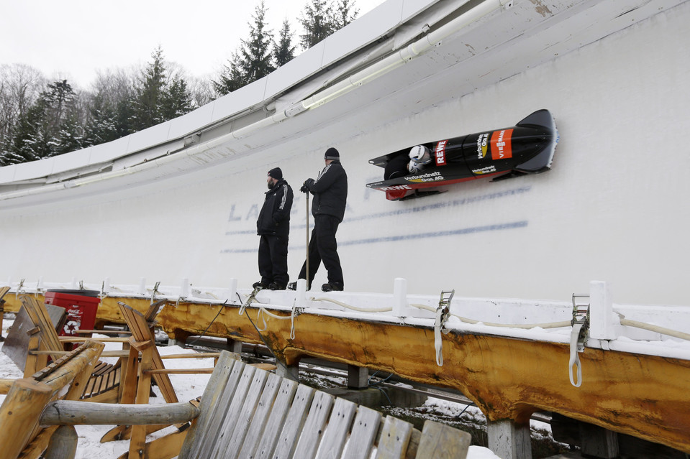
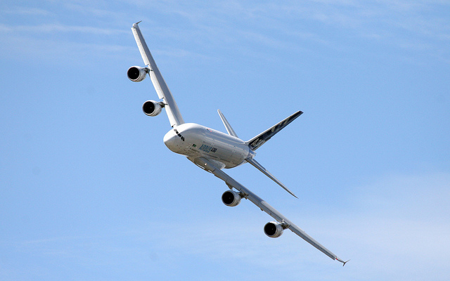
Horizontal Circular Motion and Banked Turns

Slide 2
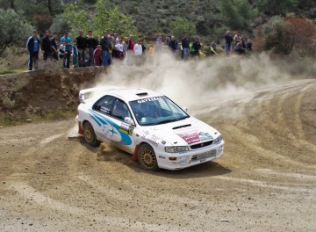
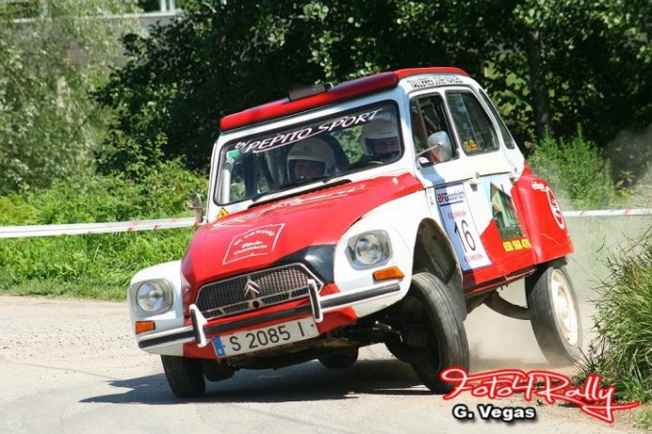
Circular Motion and Friction
When a car travels without skidding around a curve, the static frictional force between the tires and the road provides the centripetal force.

Slide 3
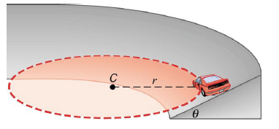
Circular Motion and Friction
The reliance on “friction” can be eliminated completely for a given speed if the curve is “banked” at an angle relative to the horizontal.

Slide 4
The Radius
Consider a car going around a banked curve as shown in the diagram.
The radius of the curve, r, is measured parallel to the horizontal and NOT to the slanted surface.

Slide 5
The Normal Force
The normal force F_{N} that the road applies to the car is perpendicular to the road.
Because the roadbed makes an angle θ with respect to the horizontal, the normal force has a component F_{N} sin θ, which is in the direction of the radius.

Slide 6
Providing a Centripetal Force
The inward component of the normal force is in the direction of the centripetal force required to keep the car moving around the cirlce.
Thus, the banked turn can be used to provide the centripetal force instead of relying on friction.
F_{c} = F_{N} sin θ = mv²
r

Slide 8
Providing a Centripetal Force
Also, since the car does not accelerate in the vertical direction, the vertical component of the normal force must be equal to the weight, that is:
F_{N} cos θ = mg

Slide 9
Providing a Centripetal Force
Since F_{N} sin θ = mv²
r
and F_{N} cos θ = mg
Then F_{N} sin θ = mv²r⁻¹
F_{N} cos θ mg
Then tan θ = v² or v = √ (rg tan θ)
rg
This gives the maximum speed possible on a banked turn without friction

Slide 10
Providing a Centripetal Force
Alternately, using SOH CAH TOA
tan θ = opp
adjacent
= mv²/r
mg
tan θ = v² or v = √ (rg tan θ)
rg

Slide 11
What about leaning into a bend?

Slide 12
Or a Jet “Banking”?

Slide 13
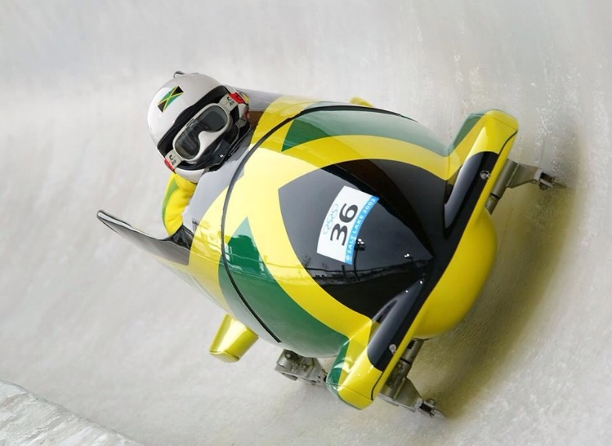
Simple Example
An engineer is tasked with designing a banked bend for a high speed winter Olympics bobsled track.
The expected maximum speed limit for the bend is 90 km/h and the average mass of a 2 person team with their sled is 250kg. The radius is 100 m.
What angle must the bend be banked so that they can safely navigate the bend without relying on friction.

Slide 14
Don’t mess it up!

Slide 15
WACE Banked Track Question
The diagram to the right shows the forces acting on a car following a curve on a banked track.
The car is travelling at 17.0 m s⁻¹ without slipping.
Calculate the radius of the track.

Slide 16
WACE Banked Track Question

